Slide 1
Link State Routing Simulator
Name: Suyog Kharage
CWID : A20402686

Slide 2
Link State Routing Protocol
What is Link State Routing Protocol ?
protocols maintain complete road map of the network
Each router of this protocol originates information about the router, its directly connected links, and the state of those links
This protocol is used to determine the shortest reachable path from source router to the destination router
Link state protocols are based on Dijkstra algorithm algorithm to find the best path to a destination.

Slide 3
Dijkstra’s Algorithm
For a given source node in the graph, the algorithm finds the shortest path between that node and every other
It can also be used for finding the shortest paths from a single node to a single destination node by stopping the algorithm once the shortest path to the destination node has been determined
One can find the shortest paths from a given source to all points in a graph in the same time
This problem is sometimes called the single-source shortest paths problem

Slide 4
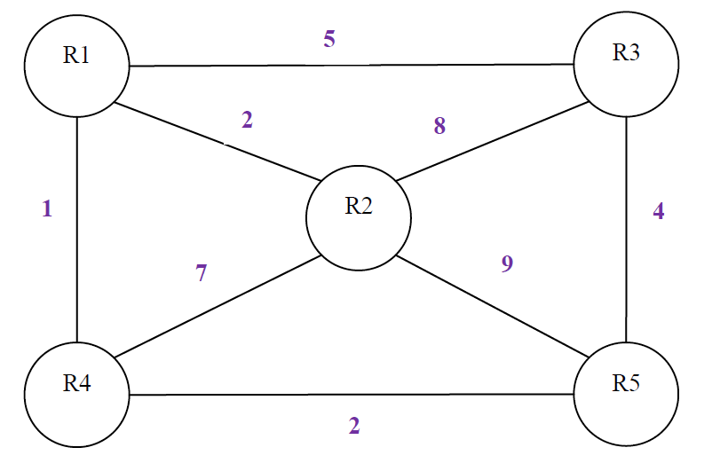
Sample Network Topology

Slide 5
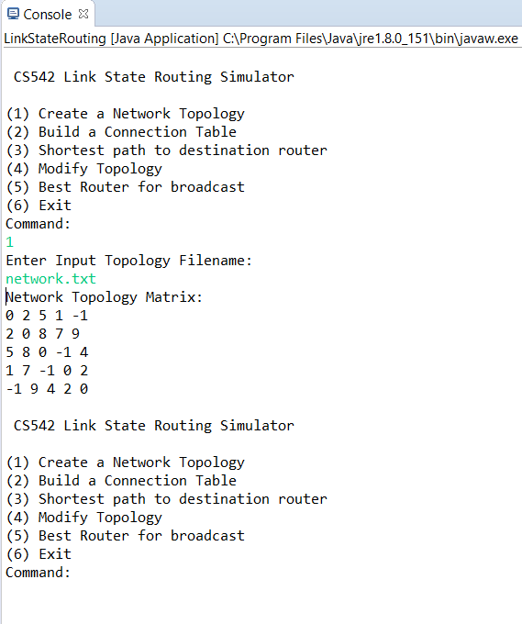
Option 1 – Create network topology

Slide 6
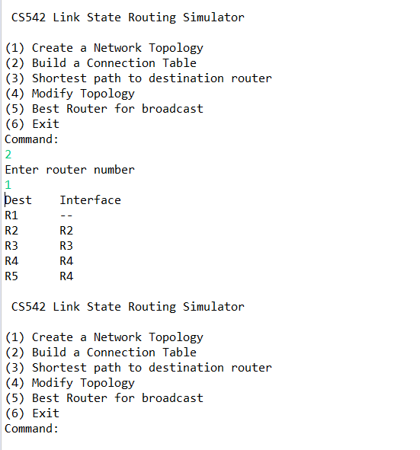
Option 2 – Build Connection Table
After entering router number for calculating connection table

Slide 7
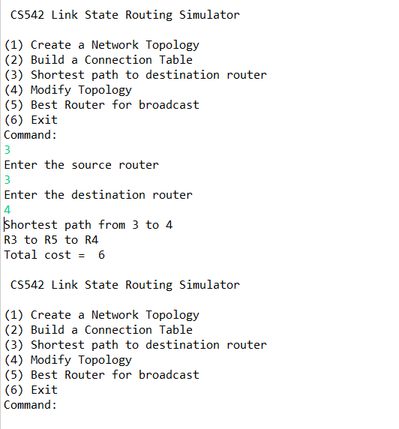
Option 3 – Find Shortest Path
After entering source and destination router,
Dijkstra’s algorithm will compute shortest distance path between those two routers and display it to the user.

Slide 8
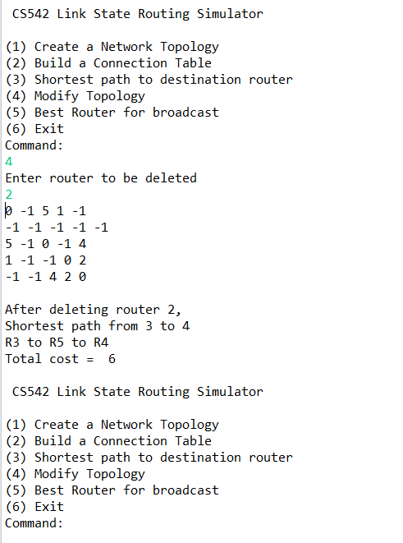
Option 4 – Modify Topology
After entering router number to be deleted,

Slide 9
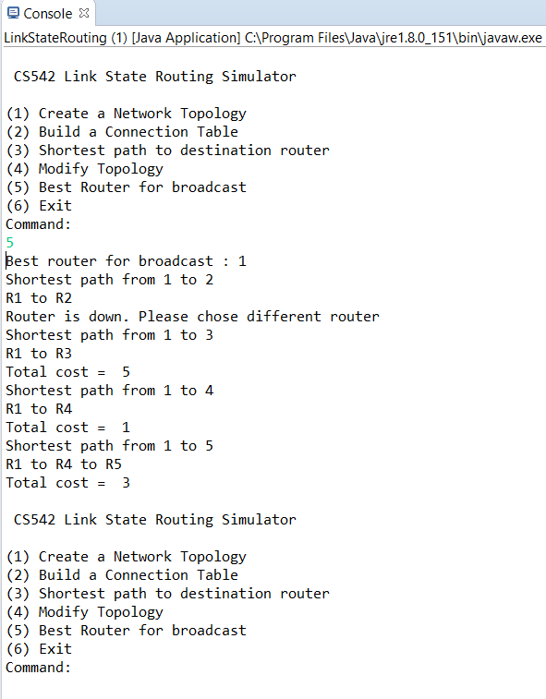
Option 5 – Best Router for Broadcast
After choosing option for best router, along with best router it also shows cost to all router from best router

Slide 10
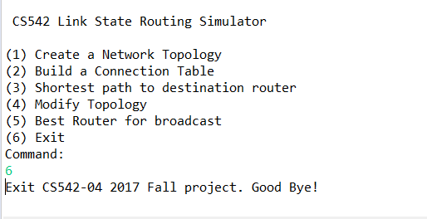
Option 6 - Exit

Slide 11
Thank You..!

